Slide 1
Quantum Essentials
What is a quantum system?

Slide 2
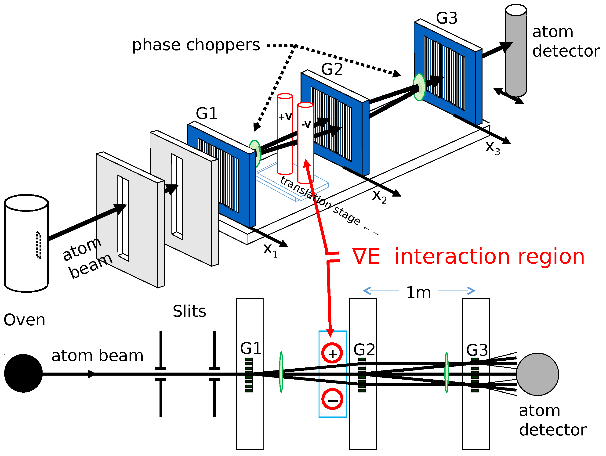
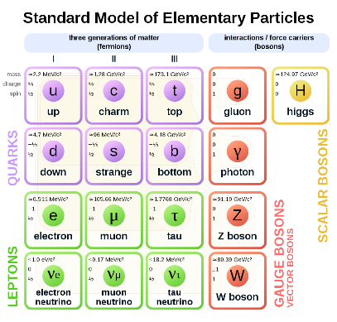
Quantum mechanics is about fundamental objects!
Composite objects can exhibit quantum properties
Protons, atoms and molecules can, in some cases, be treated as a single quantum object (e.g. interferometry)
Quantum mechanics describes electrons, photons, quarks, …

Slide 3
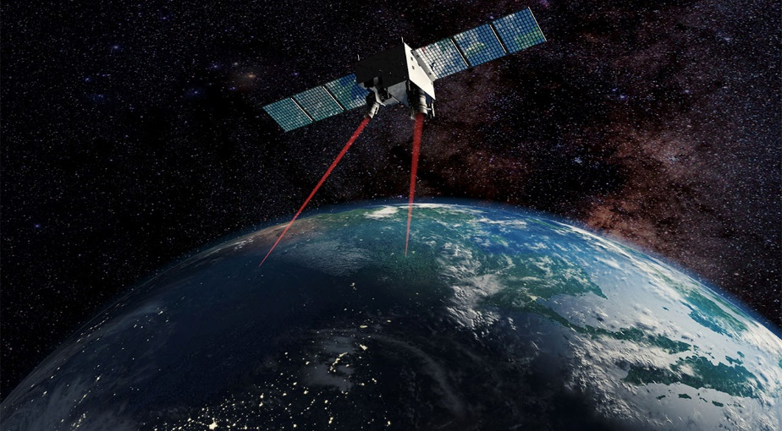









Quantum mechanics is about small objects!
Large objects can exhibit quantum properties
size in $m$
$${10}^{−12}$$
$${10}^{−9}$$
$${10}^{−6}$$
$${10}^{−3}$$
$${10}^{0}$$
$${10}^{3}$$
$←$ more quantum
more classical $→$
Quantum mechanics is for small scales and classical mechanics is for large scales
We can take two entangled photons and put them 1000 kilometers apart

Slide 4
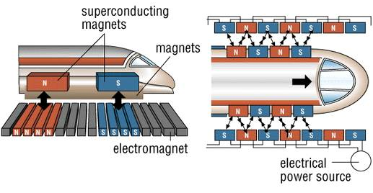





Quantum mechanics is about small objects!
Large objects can exhibit quantum properties
size in number of particles
$${10}^{0}$$
$${10}^{3}$$
$${10}^{6}$$
$${10}^{9}$$
$${10}^{12}$$
$${10}^{15}$$
$←$ more quantum
more classical $→$
Quantum mechanics is for simple objects and classical mechanics is for objects with a lot of particles
Superconductivity and super-fluidity are quantum effects with large numbers of particles
Notes:
https://www.savagevision.com/scmaglev
niobium-titanium
https://en.wikipedia.org/wiki/Niobium%E2%80%93titanium
Type II superconductor
https://en.wikipedia.org/wiki/Macroscopic_quantum_phenomena#Type_II_superconductivity

Slide 5
Quantum systems are fundamental
Quantum systems are irreducible!
Quantum systems are made of few particles
Quantum systems are small in size

Slide 6
Classical vs Quantum
Reducible vs Irreducible

Slide 7
red marker
Take a ball
ball
motion
Study its motion
Take a red marker,
make a dot on the ball
time
Study the motion of the dot
Studying the ball is equivalent to studying all possible red dots
The state of the whole tells you everything about the state of the parts and vice-versa
The ball is reducible (to its parts)

Slide 8





Assuming infinitesimal reducibility recovers classical mechanics
Phase space $𝒮$ is the state space of infinitesimal parts
Each finite object is a distribution $ρ :𝒮→ℝ$ over phase space
$$p$$
The structure of phase space makes the density coordinate invariant: $ρ\left(x^{i},p_{i}\right)=ρ\left({\hat{x}}^{i},{\hat{p}}_{i}\right)$ because $dx^{i}dp_{i}=d{\hat{x}}^{i}d{\hat{p}}_{i}$
$$x$$

Slide 9
red marker
Take an electron
electron
motion
Study its motion
Can’t mark a part of the electron
?
time
Can’t study the motion of parts
You can only study (interact with) the whole electron
The state of the whole tells you nothing about the state of the parts
The electron is irreducible (to its parts)

Slide 10



Assuming irreducibility recovers quantum mechanics
Can’t fully describe the density of the parts
Can’t track the motion of individual parts of the distributions
$$ρ\left(x^{i},p_{i}\right)→ψ(x^{i})$$
Complex numbers capture variance and correlations
?
$$σ_{X+Y}^{2}=σ_{X}^{2}+σ_{Y}^{2}+2σ_{X}σ_{Y}ρ_{X,Y}$$
$${\left|c_{1}+c_{2}\right|}^{2}={\left|c_{1}\right|}^{2}+{\left|c_{2}\right|}^{2} \\ +2\left|c_{1}\right|\left|c_{2}\right|\cos\left(θ_{2}−θ_{1}\right)$$
$$x$$

Slide 11
Irreducibility and quantum effects

Slide 12
Quantum effects and composite systems
Even a composite system, like a proton, an atom, or a molecule, can behave as a single quantum system as long as the process is not sensitive to the constituents
But if, for example, you go to higher energies, you become sensitive to the dynamics of the constituents (i.e. quarks, nucleons, atoms)

Slide 13

Entanglement
Two quantum systems (e.g. two photons) can form a single, irreducible system
But if you start interacting with only one constituent, you break the entanglement

Slide 14
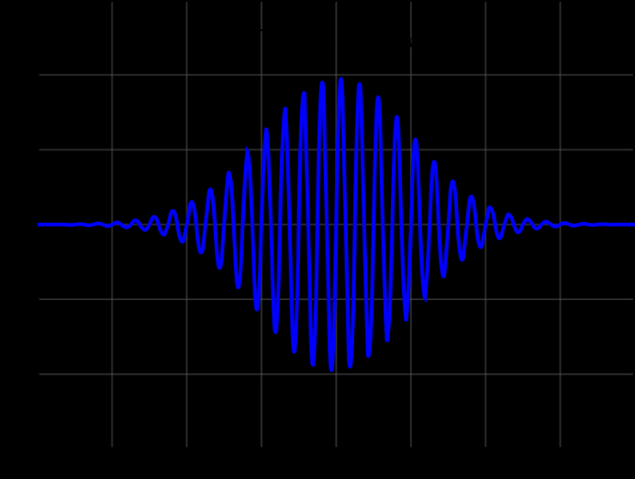
Wave-like nature
A quantum state is a “probability / matter” wave “distribution” as the parts move in a way not completely specified by the state
We can’t precisely say that it’s a probability distribution or a matter distribution because that means saying what the parts are doing

Slide 15
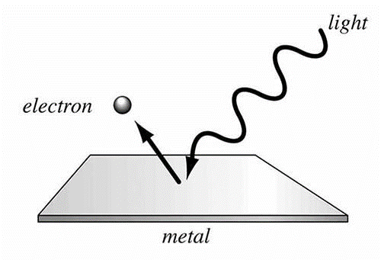
Particle-like nature
The system is irreducible and therefore behaves as a single unit
As long as the assumption is valid, we cannot interact with one part independently from the rest

Slide 16

Quantum uncertainty
The uncertainty comes from the inability to describe the parts
$$ΔxΔp≥\frac{ℏ}{2}$$
A precise distribution in both position and momentum constrains more and more the state of the parts, which irreducibility forbids

Slide 17
Non-locality
A quantum system is non-local as it is distributed in space (see uncertainty) and must behave as a single unit (particle nature)
If we could interact only with the part of the system within a region, we would violate irreducibility (i.e. we would be able to interact with a part)

Slide 18
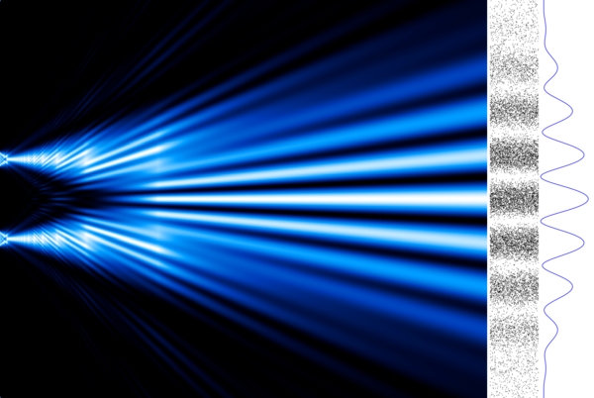
Interference
When parts overlap, for example spatially, the correlations lead to interference (constructive if correlated, destructive if anti-correlated)
Superposition is the linear combination of the stochastic description

Slide 19
Classical
vs
Quantum
red marker
red marker
ball
motion
electron
motion
?
time
time
Reducible
vs
Irreducible

